Slide 1
October 2024

Slide 2
Sexual Health Key Messages
October 30, 2024
Highest weekly average last week 178 sexual health visits / day Highest number of daily service users on Monday July 8, 2024 at 220 users New visits have stabilized. Our testing is significantly less expensive than Public Health.
Successful Code for Canada Hackathon Idea 1: Improve kiosk check-in process Idea 2: Automate mass sending of all negative results (80% of patients)

Slide 3
Cumulative data on sexual health visit from July 2022 to October 2024
63311 visits 13993 individuals

Slide 4
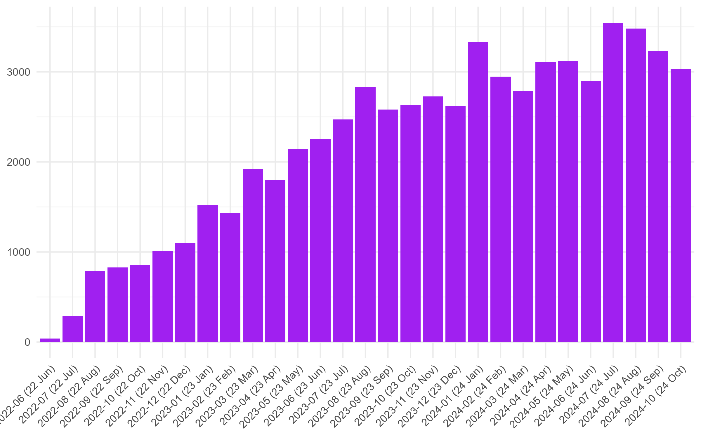
First vs Return July 2023 - June 2024
04,725 visits in 2022 27,025 visits in 2023 18,986 visits in 2024

Slide 5
Demographics July 2022 to October 2024
Average Age: 34
HIV Positive: 10%
Cis Male: 87%
Trans Male: 1%
Trans Woman: 1.6%
Non-Binary: 5.6%
Other Gender: 1.6%

Slide 6
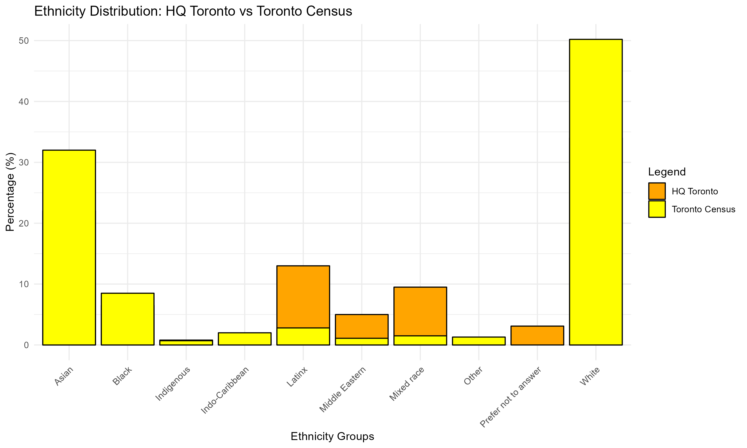
Ethnicity by individuals July 2022 to June 2024

Slide 7
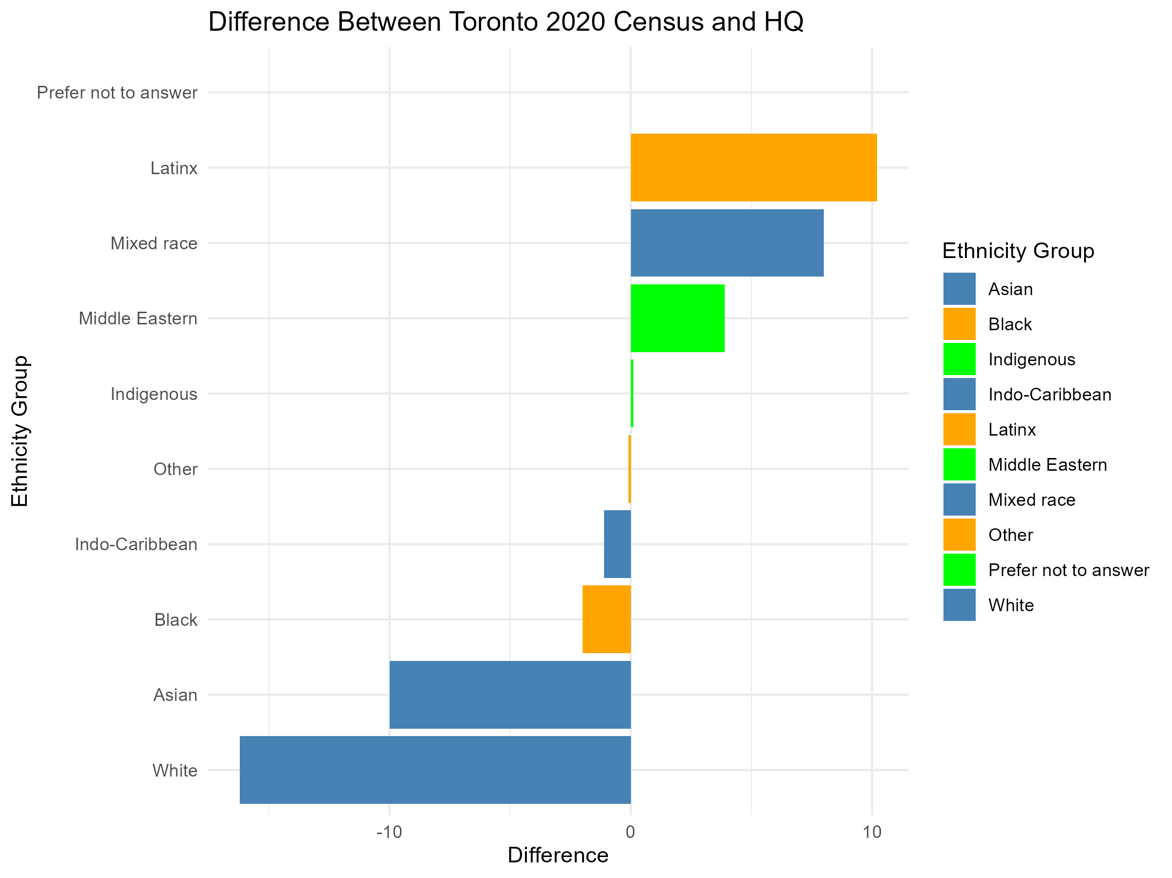
Ethnicity (Difference between Toronto 2020 Census and HQ)

Slide 8
Improving the Health of Our Community
302716 Test Results 48404 Treatment:

Slide 9
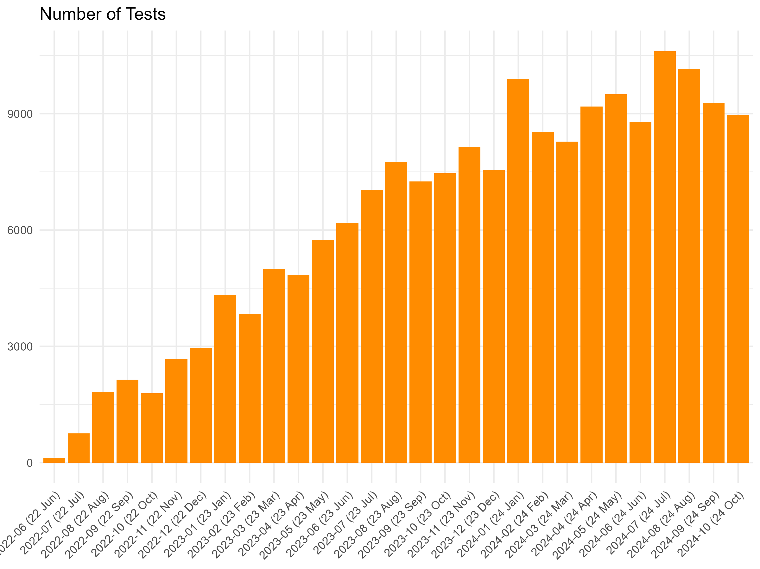
Cumulative data on sexual health visit

